Slide 1
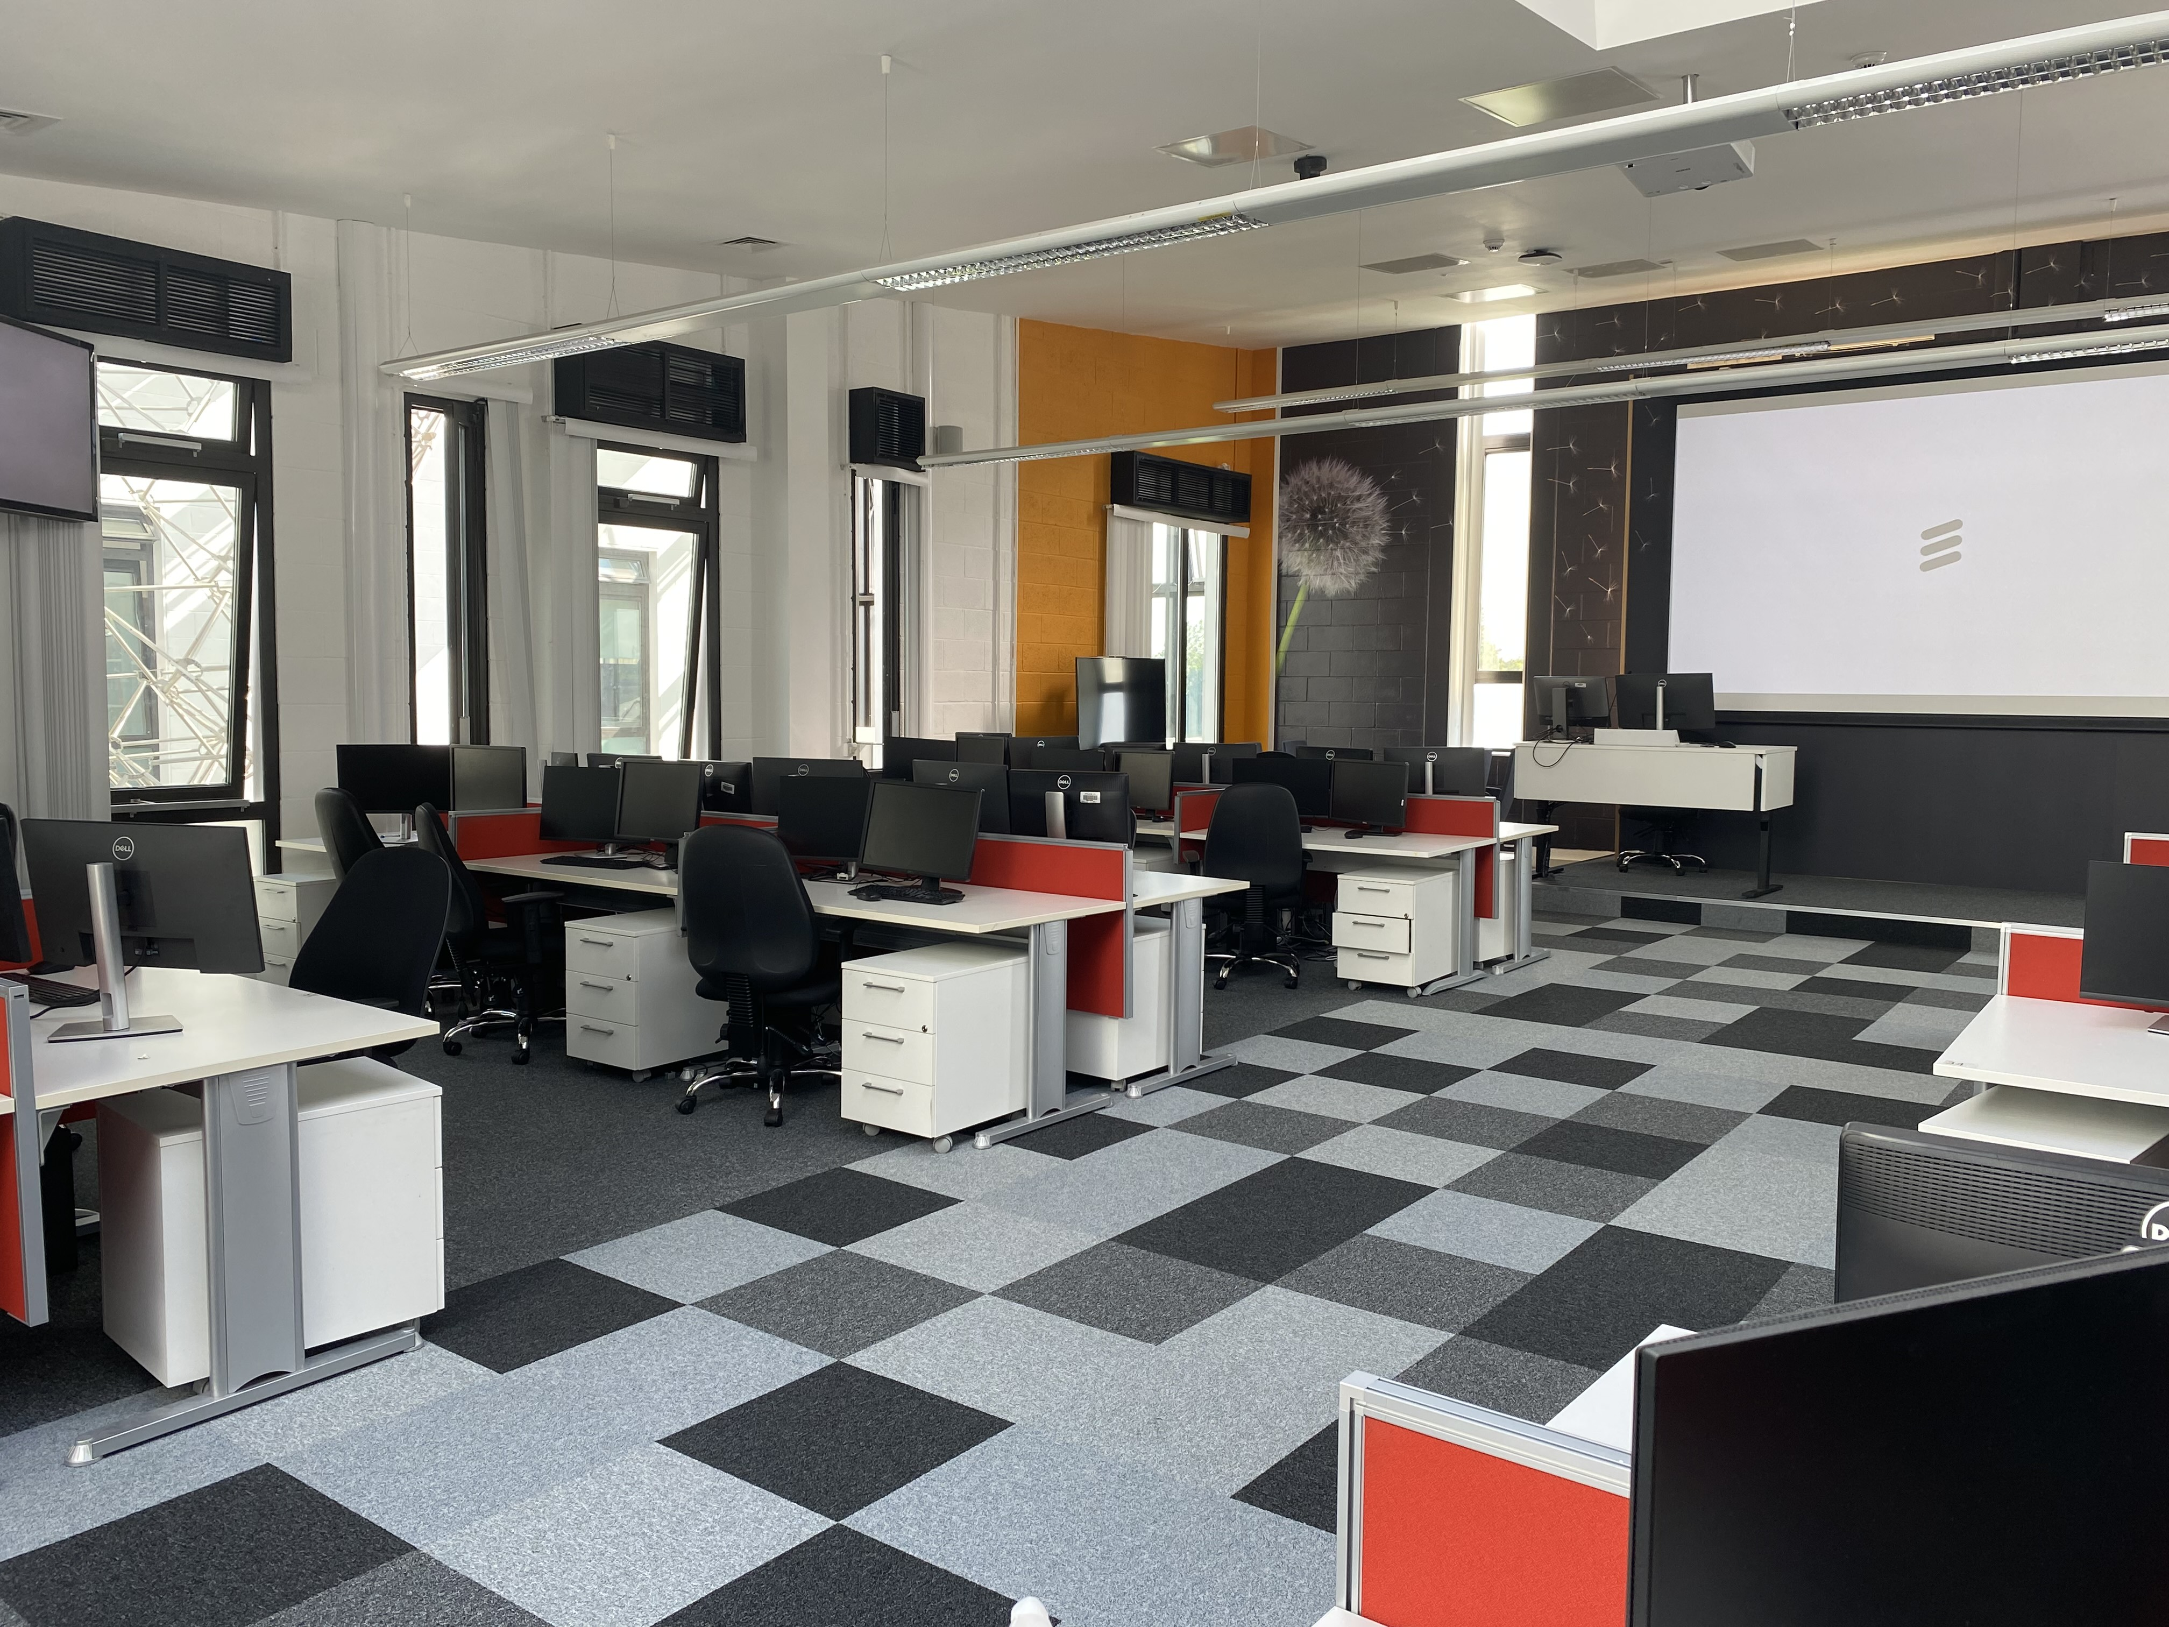
Certificate in Software Engineering CSE
Dr. Sheila Fallon
Course Coordinator

Slide 2

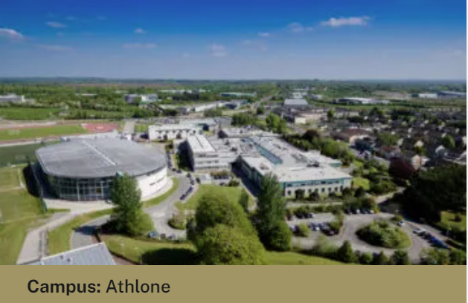

Technological University of The Shannon
6 Campuses, over 15 000 Students
Engineering building.

Slide 3

Certificate in Software Engineering
Preparatory programme for the MSc in applied Software Engineering
30 credit special purpose award
CSE results together with an interview with Ericsson determine
progression to the Masters in Applied Software Engineering.

Slide 4
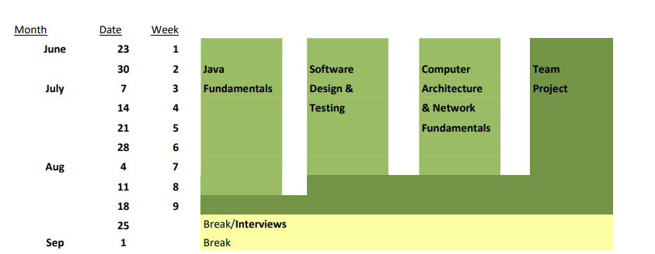
CSE Schedule

Slide 5
Hybrid delivery
The CSE is hybrid/blended delivery
The time you spend in TUS in critical to delivery of this programme.
Teamwork is an integral part of the CSE and Software Engineering

Slide 6
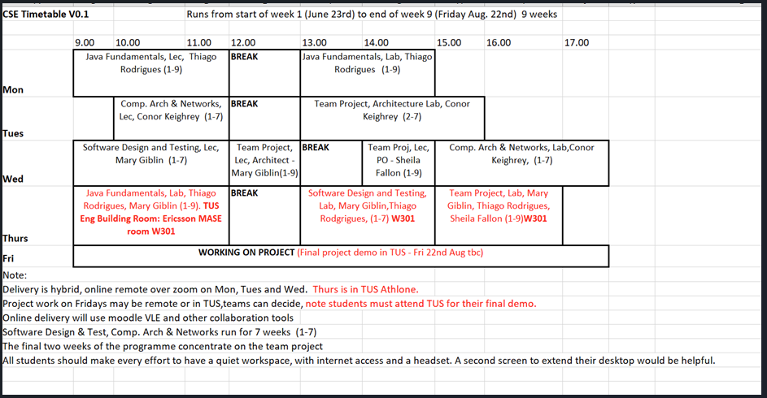
Timetable

Slide 7
Support
Attendance is key to your success on the CSE
Let someone know if you have questions or need support:
Classmates and your Team
Lecturers
Course Coordinator
Athlone Student Resource Centre Team
https://tus.ie/student-support/athlone-student-resource-centre/

Slide 8
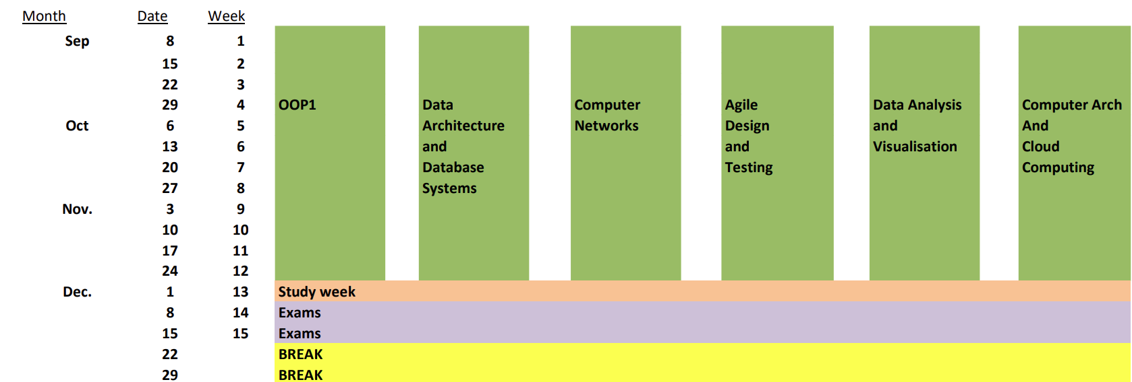
Towards the MSC

Slide 9
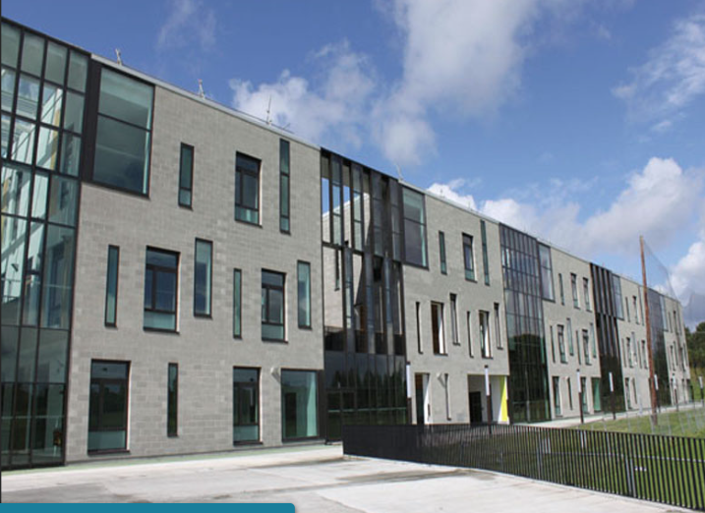
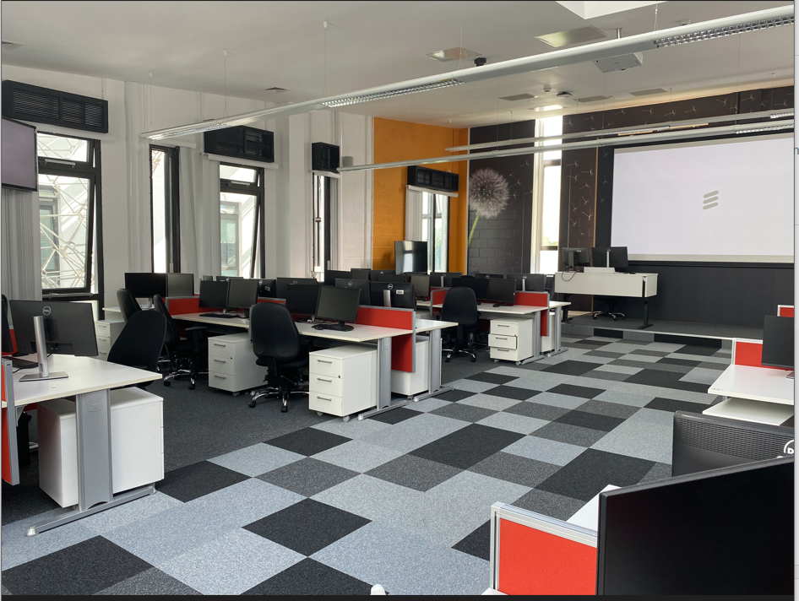
Thursday 26th June
Engineering Building in TUS Athlone
Top floor – W301 – sit in one of the seats assigned to your team

Slide 10
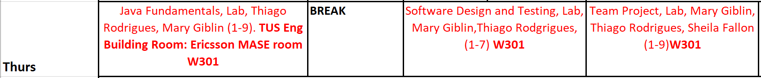
Thursday 27th June
9-11:30 | Java
11:30 -12:00 | Welcome from Ericsson - Barbara Quinn will meet the class
12:15 – 1:45 | Please visit the Student Card Office in the main building. Rory Kiernan will be expecting you. Lunch
1:45 – 3:15 | Agile Design & Test
3:15 | Team project

Slide 11
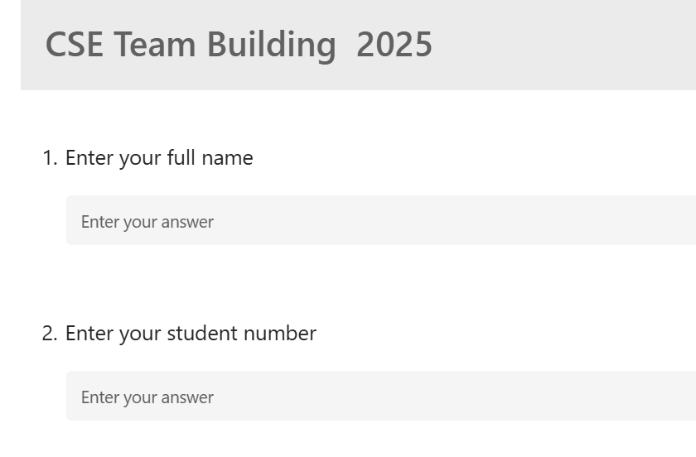
Team building survey
You should have received an email with our teambuilding survey.
You must complete this short survey by
4PM today Wed 25th June.
If you do not receive the link – email me.

Slide 12
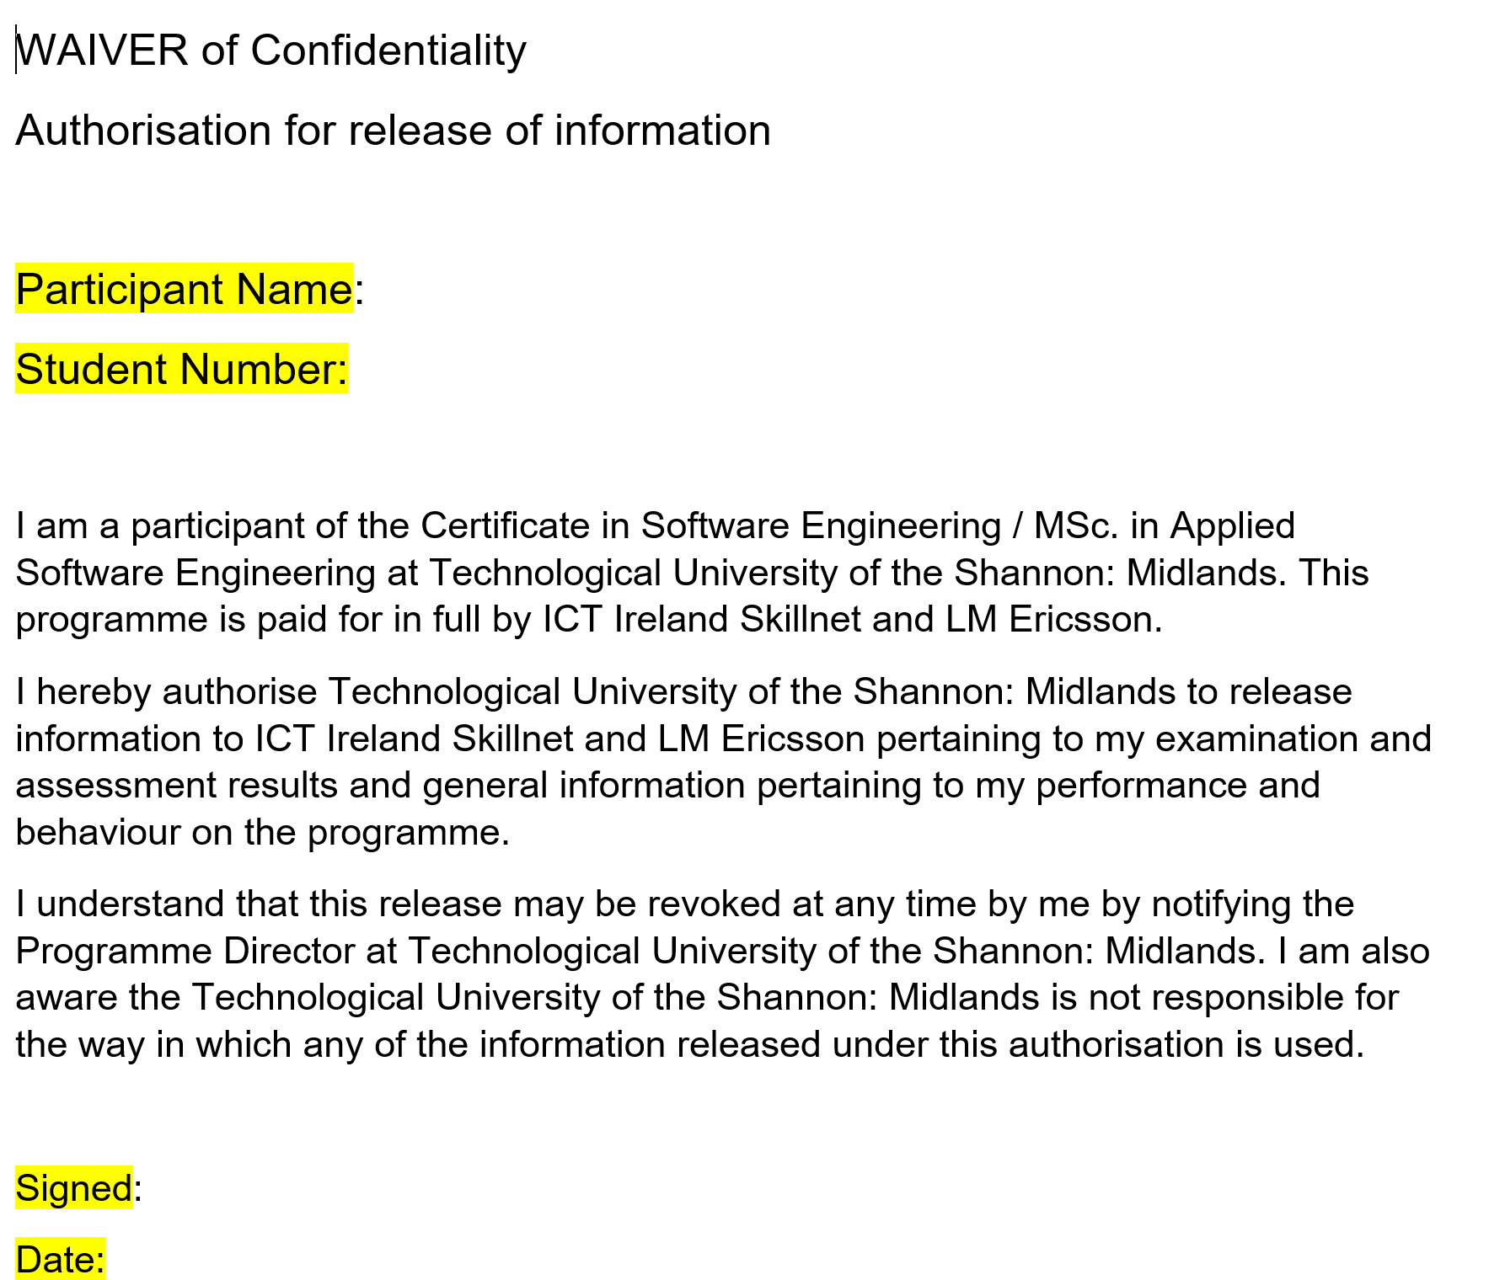
Waiver of Confidentiality form
I will give out copies of this waiver tomorrow, it is important you sign a copy.

Slide 13



